Slide 1
Forging
Visit for more Learning Resources

Slide 2
CO
Identify and select proper manufacturing process for a specific component.

Slide 3
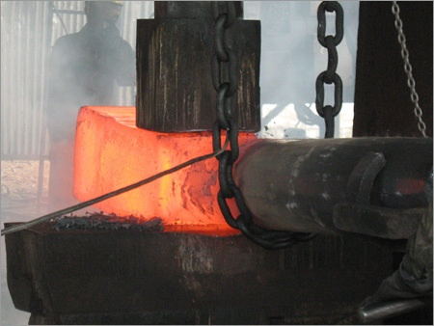
What is Forging?
It`s a term used for shaping metals and alloys using localized compressive forces.
Stresses induced > Yield strength
Strain Hardening
Type of loading – Compressive, Bending, Shear, Combination of these
http://product-image.tradeindia.com/00245643/b/Shaft-Forging-Process.jpg

Slide 4
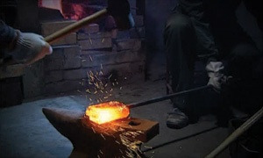
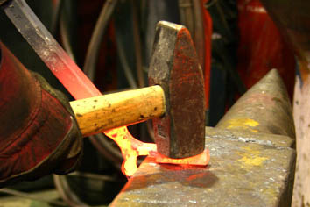
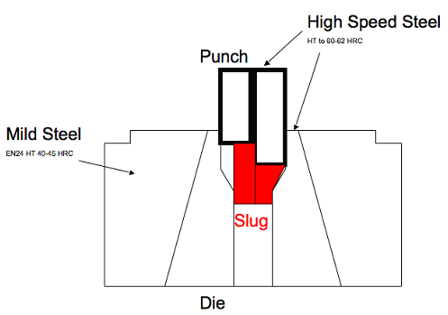
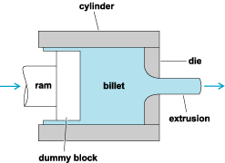
Categories
Hot forging
Cold forging
http://www.paul-chen-swords.com/content/images/katana-forging-
process-1-rough-forging.jpg
http://www.verdigrismetals.co.uk/work%20being%20made/hot%20forged%20steel%201.jpg
http://www.coldforge.com/img/Cfp1.gif
http://www.coldforge.com/img/Cfp1.gif

Slide 5
Forging Materials
Almost all metals and alloys can be forged.
Ferrous alloys
Aluminum alloys
Brass and Bronze
Copper alloys
Titanium alloys

Slide 6
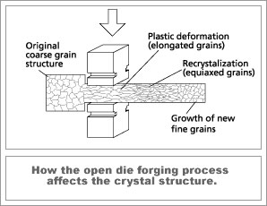
What happens in forging?
http://www.sssforge.com/images/pic-01.jpg

Slide 7
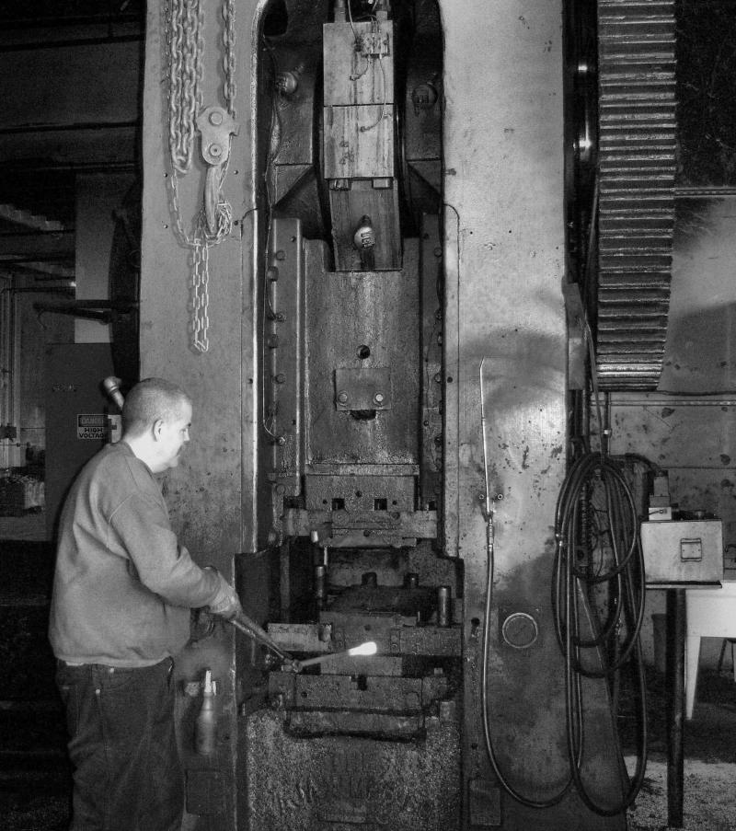
Types of Forging
Hammer Forging (Flat Die)
Instantaneous Load
Intermittent blows
Steam or Air pressure
Poor surface finish
http://rrforging.com/yahoo_site_admin/assets/images/forge3.354112844_std.jpg

Slide 8
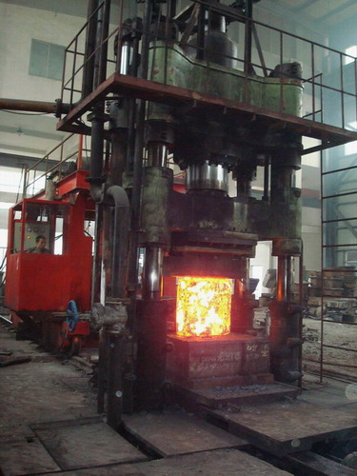
Types of Forging
Press Forging
Slow continuous pressure
Pressure extends deep into material
Greater proportion of energy
transferred to material
Better surface finish
http://img2.tradeget.com/forginghammer%5CWJ0Y6F6G1forging_manipulator_with_open_die_forging_press.jpg

Slide 9
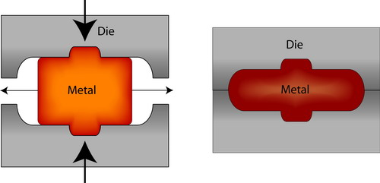
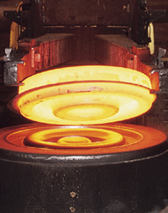
Types of Forging
Die Forging
http://www.msm.cam.ac.uk/doitpoms/tlplib/metal-forming-2/figures/closeddieforge_sml.jpg
http://www.firthrixson.com/images/forgings.jpg
Material is forced to fill the recessions
Complex shapes can be obtained
Close dimensional tolerances can be achieved

Slide 10
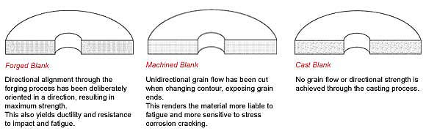
Forging as compared to other manufacturing Processes

Slide 11
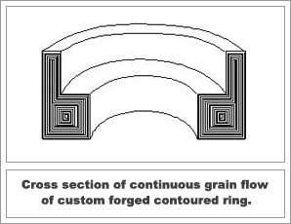
Advantages
Part Integrity
Directional Strength
Grain structure is refined
Structural Strength
Eliminates internal voids and gas pockets
Impact strength
Forging improves fracture toughness, impact toughness and fatigue strength
http://www.sssforge.com/images/pic-03.gif

Slide 12
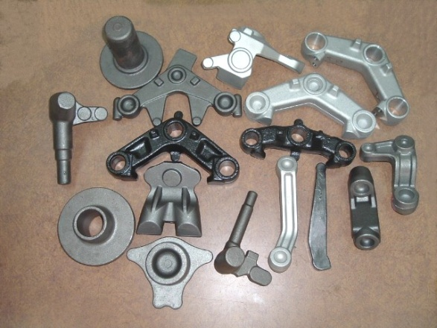
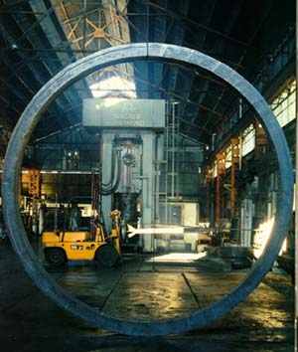
Advantages
Part Flexibility
Variety of sizes
Not limited to size
Variety of Shapes
Not limited to shape
Metallurgical spectrum
All types of metals and alloys can be forged
http://www.shuennyueh.com.tw/eng/FILE/2.JPG

Slide 13
Disadvantages
Cost of die
For small production quantity cost of die can be too expensive
Finishing is required
Surface finish is poor in this process

Slide 14
Bibliography
Manufacturing Science by Amitabh Ghosh and Ashok Kumar Mallik
http://www.weldaloy.com/downloads/FIA-MechancalPropertiesforforgingalloys.pdf
http://www.weldaloy.com/downloads/FIA-HowForgingsCompare.pdf
http://www.advancesourcing.com/pdf/Forgings%20PDF.pdf
http://www.forging.org/fierf/pdf/japanesesword.pdf
Other References
http://www.forging.org/facts/faq3.htm
http://www.forging.org/Design/pg1_4.html
http://www.scotforge.com/sf_facts_forgingadv.htm
http://www.efunda.com/processes/metal_processing/forging.cfm
http://www.steelforge.com/forgings/historyofforgings.htm
http://en.wikipedia.org/wiki/Forging#Advantages_and_disadvantages
http://www.ent.ohiou.edu/~raub/manufacturing/forging.htm

Slide 15
EXTRUSION

Slide 16
CO
Identify and select proper manufacturing process for a specific component.

Slide 17
Extrusion
A compression forming process in which the work metal is forced to flow through a die opening to produce a desired cross-sectional shape.
Pros:
variety of sections possible (hot extrusion)
grain structure and strength enhancement (cold)
close tolerance (cold)
no material wastage.

Slide 18
EXTRUSIONS

Slide 19
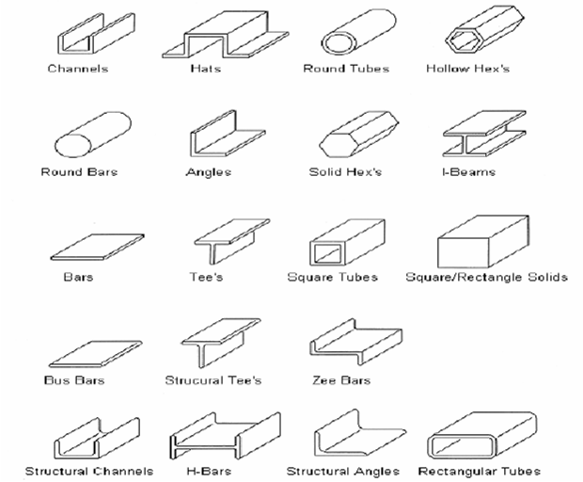
STANDARD EXTRUSIONS

Slide 20
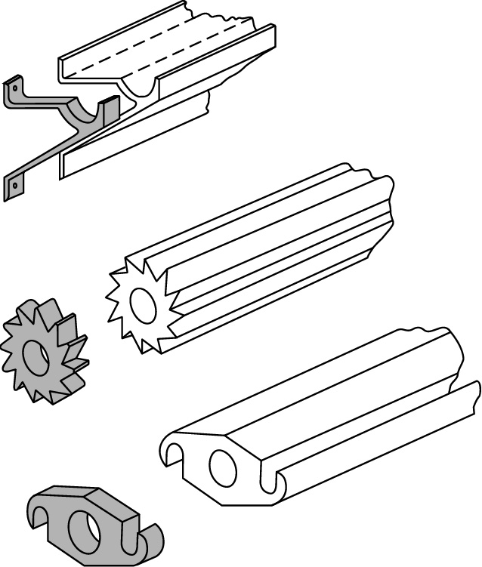
Extrusions
Figure 15.2 Extrusions, and examples of products made by sectioning off extrusions.

Slide 21
Types of Extrusion
Direct Extrusion
The ram forces the work billet metal to move forward to pass through the die opening.
Indirect Extrusion
The die is mounted to the ram rather than at the opposite end of the extruder container housing.

Slide 22
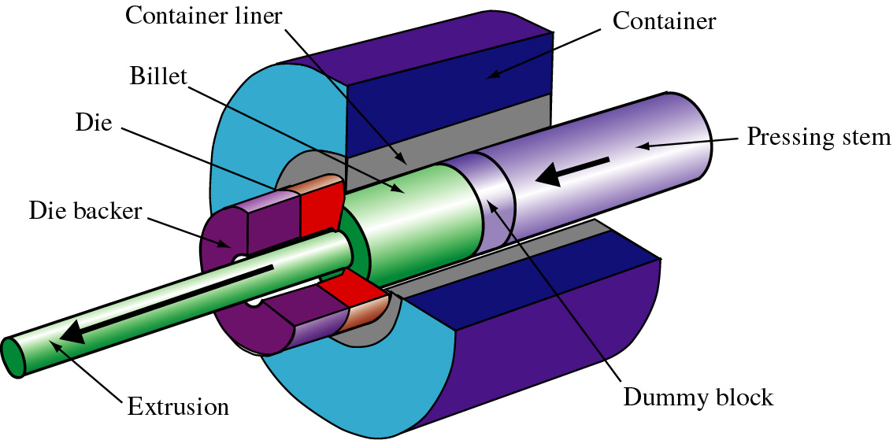
Direct Extrusion
Figure 15.1 Schematic illustration of the direct extrusion process.

Slide 23
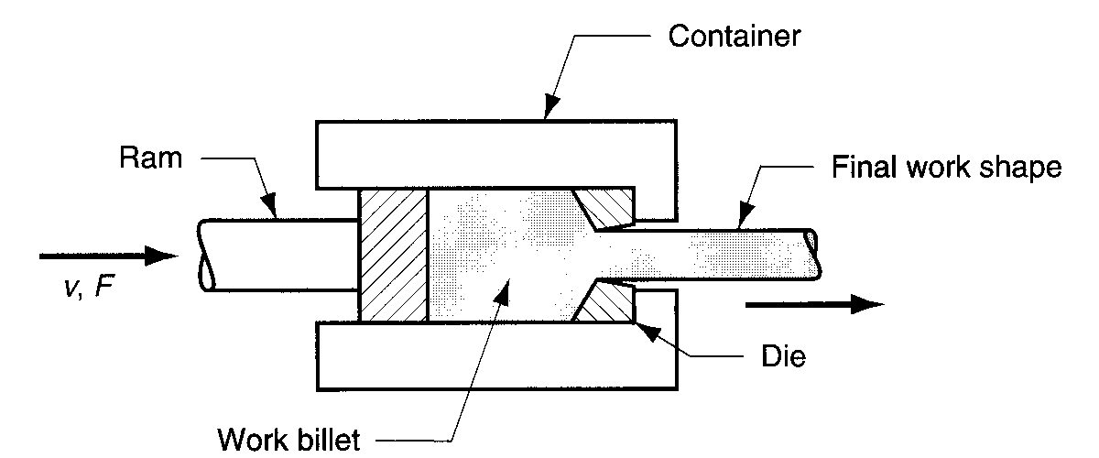
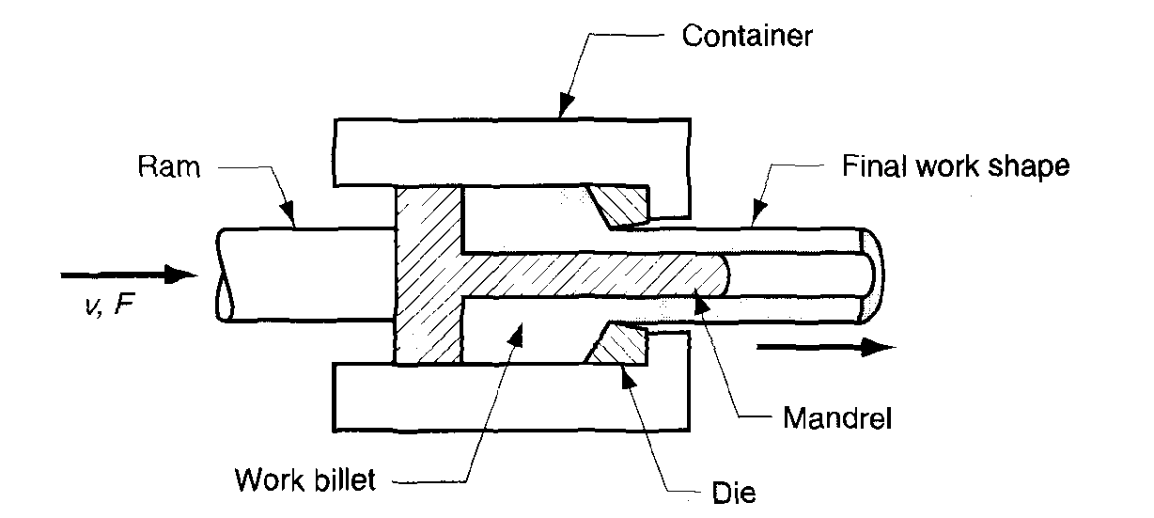

Direct Extrusion
Friction increases the extrusion force.
Hollow section is formed using a mandrel.

Slide 24
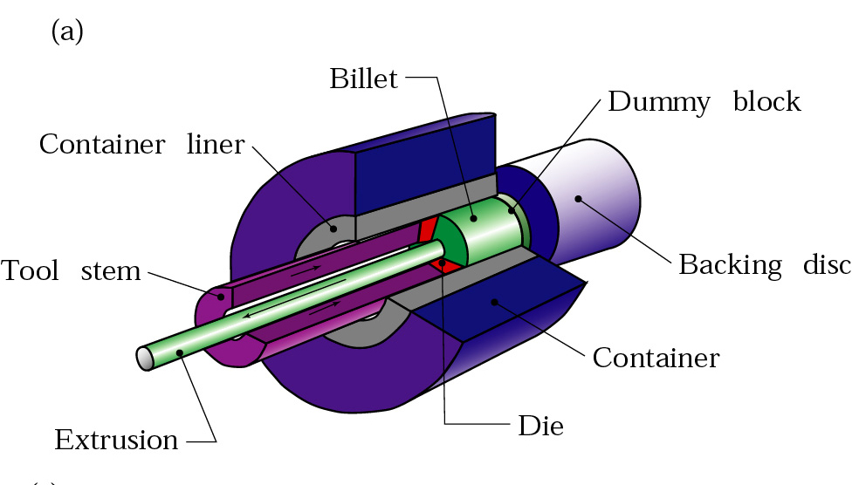
Indirect Extrusion
Figure 15.3 Types of extrusion: (a) indirect; (b) hydrostatic; (c) lateral.

Slide 25
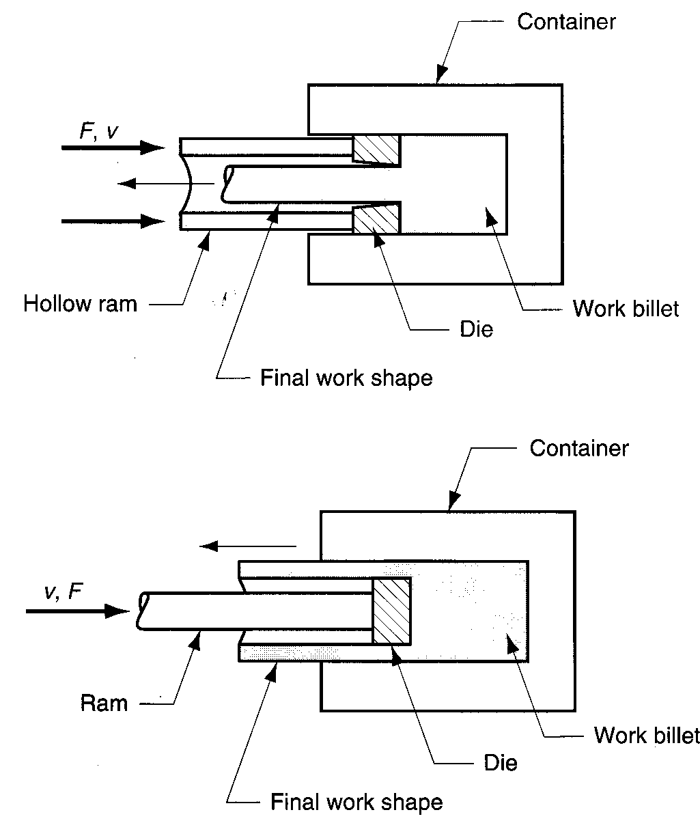
Indirect Extrusion
Metal is forced to flow through the die in an opposite direction to the ram’s motion.
Lower extrusion force as the work billet metal is not moving relative to the container wall.

Slide 26
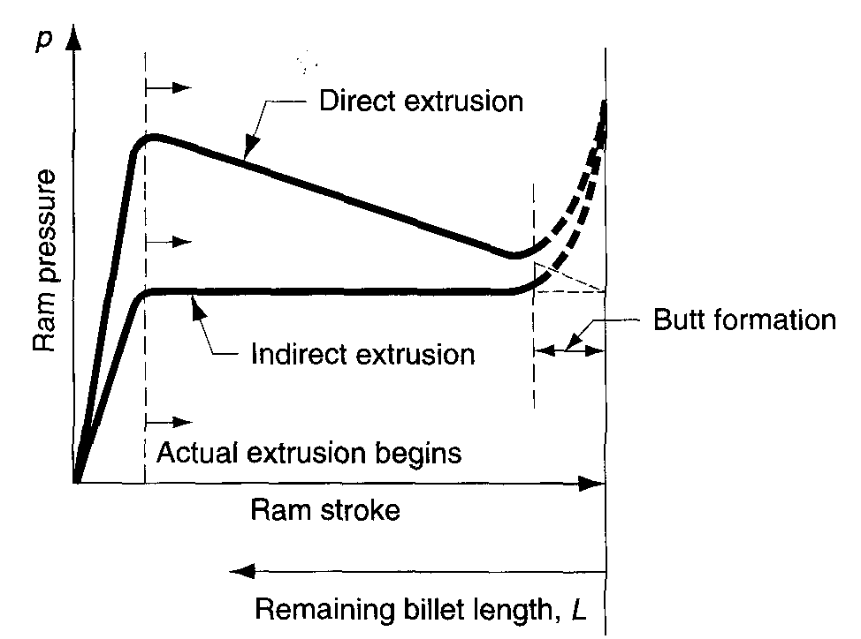
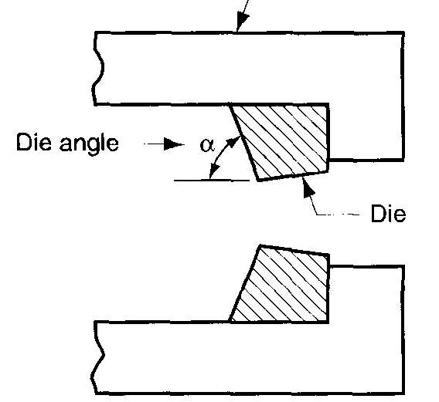
Ram Force
Variation of Ram Force with ram stroke and die angle.

Slide 27
EXTRUSION

Slide 28
Extrusion Processes
Hot extrusion
Keeping the processing temperature to above the re-crystalline temperature. Reducing the ram force, increasing the ram speed, and reduction of grain flow characteristics. Controlling the cooling is a problem. Glass may be used as a lubricant.
Cold extrusion
Often used to produce discrete parts. Increase strength due to strain hardening, close tolerances, improved surface finish, absence of oxide layer and high production rates.

Slide 29
Extrusion Temperature Ranges for Various Metals

Slide 30
Impact Extrusion
Impact extrusion is performed at higher speeds and shorter strokes than conventional extrusion.
It is for making discrete parts.
For making thin wall-thickness items by permitting large deformation at high speed.

Slide 31
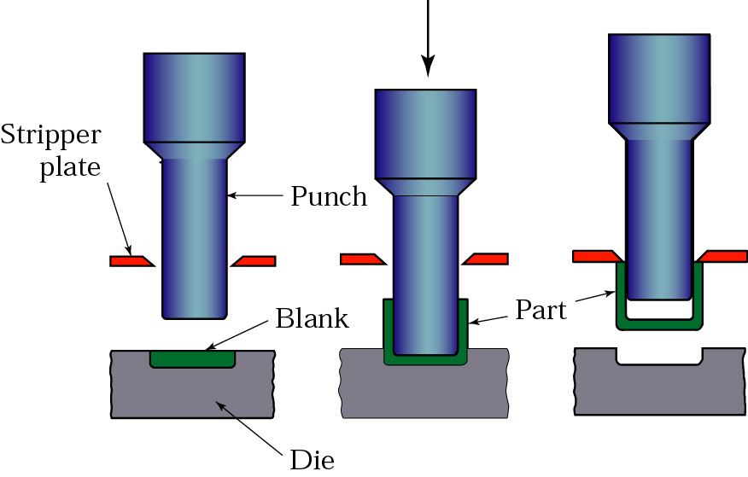
Impact Extrusion
Figure 15.14 Schematic illustration of the impact-extrusion process. The extruded parts are stripped by the use of a stripper plate, because they tend to stick to the punch.

Slide 32
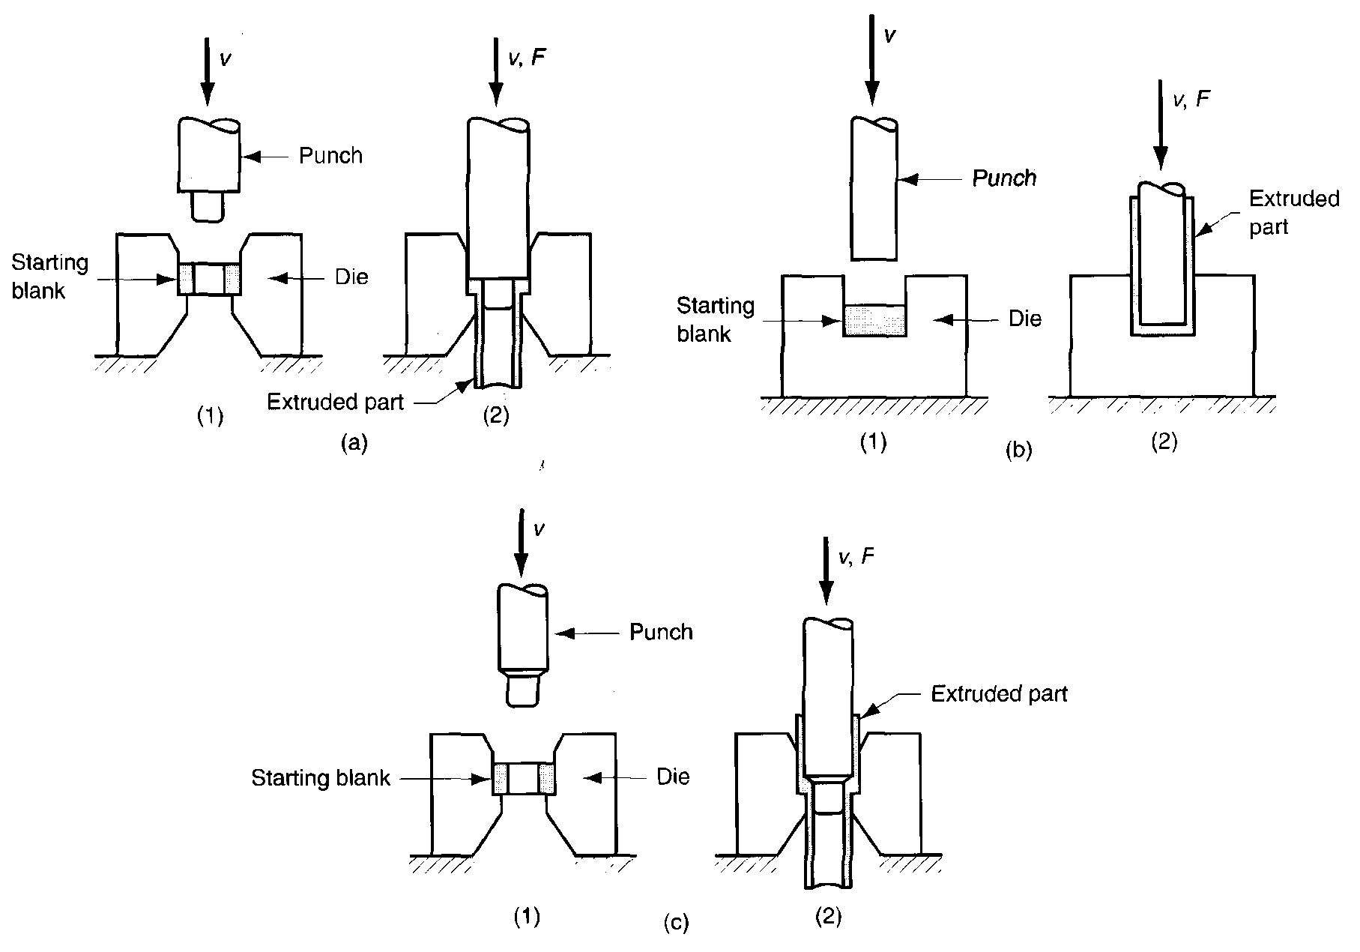
Impact Extrusion
Forward
backward
combination

Slide 33
Examples of Impact Extrusion
Figure 15.15 (a) Two examples of products made by impact extrusion. (b) and (c) Impact extrusion of a collapsible tube by the Hooker process.

Slide 34
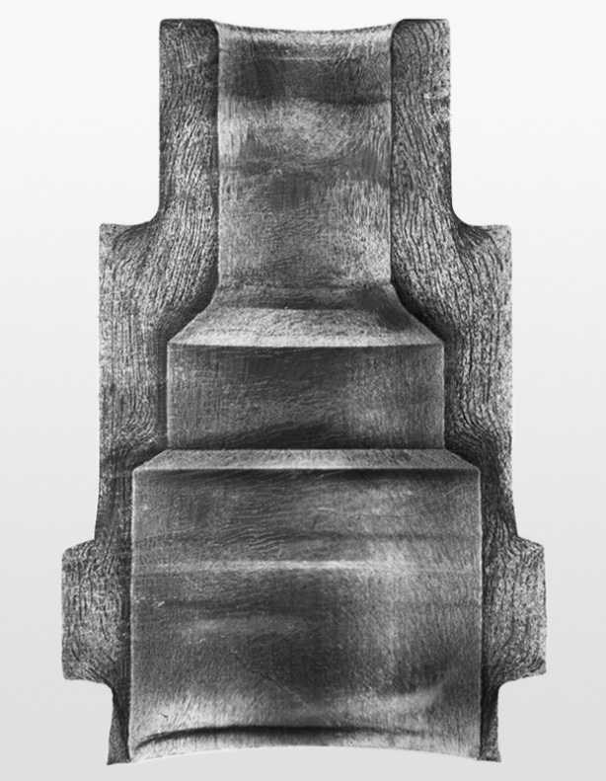
Cold Extruded Spark Plug
Figure 15.12 Production steps for a cold extruded spark plug.
Figure 15.13 A cross-section of the metal part in Fig. 15.12, showing the grain flow pattern.
For more detail contact us

